Slide 1
Survival analysis and regression – Part 3
Michael Otterstatter
BCCDC Biostats Session
November 22, 2019

Slide 2
Session overview
In this session we will
continue discussing the structure and assumptions of regression models for survival data
consider extension of these regression models using time-varying covariates

Slide 3

Reminder: survival analysis
Define event of interest, time zero, time scale and how participants exit
Consideration of censoring
Descriptive analysis: univariate modeling
KM curves and descriptive statistics
Inferential analysis: multivariate modeling
Cox regression (semi-parametric)

Slide 4
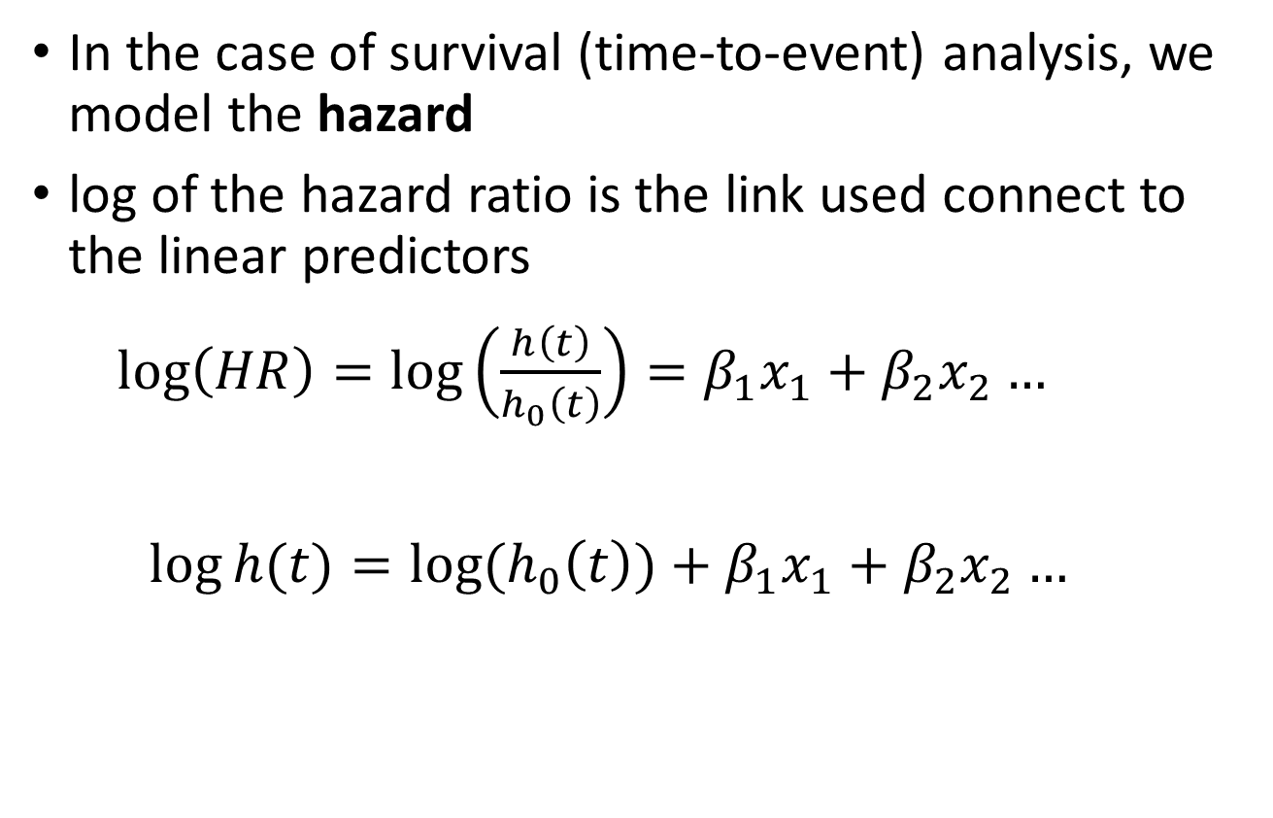
Reminder: Proportional hazards models
In the case of survival (time-to-event) analysis, we model the hazard
log of the hazard ratio is the link used connect to the linear predictors
$\log\left(HR\right)=\log\left(\frac{h\left(t\right)}{h_{0}\left(t\right)}\right)=β_{1}x_{1}+β_{2}x_{2}…$
$$\log{h(t)}=log⁡(h_{0}\left(t\right){)+β}_{1}x_{1}+β_{2}x_{2}…$$
Intercept slopes

Slide 5
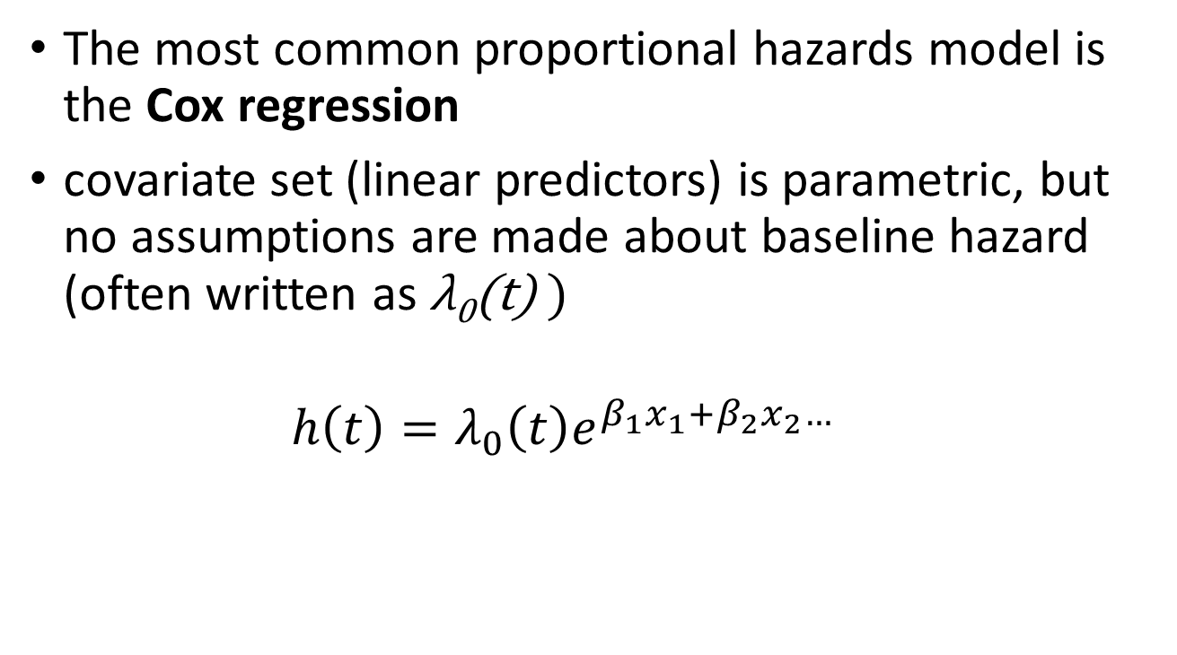
Reminder: Proportional hazards models
The most common proportional hazards model is the Cox regression
covariate set (linear predictors) is parametric, but no assumptions are made about baseline hazard (often written as λ₀(t) )
$$h\left(t\right)=λ_{0}\left(t\right)e^{β_{1}x_{1}+β_{2}x_{2}…}$$

Slide 6
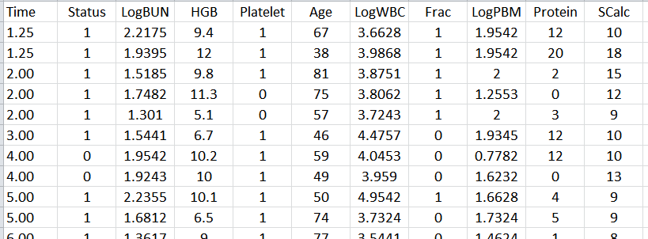
An example
Multiple myeloma study (see Krall et al, 1975)
65 patients undergoing treatment (48 died during study)
Analysis of survival time from diagnosis
Identifying factors associated with survival
Time (months)
White blood cells
Plasma cells in marrow
Serum calcium
Blood urea nitrogen
Hemoglobin
Protein in urine
Alive/Dead

Slide 7
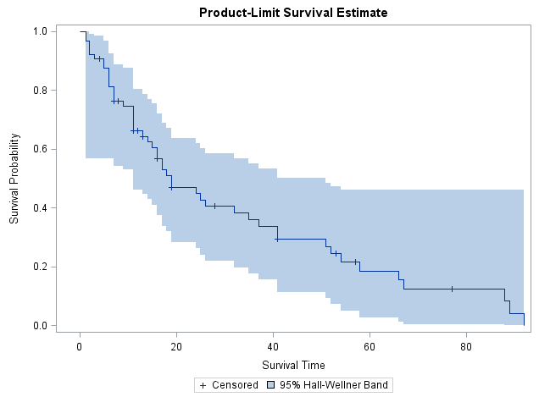
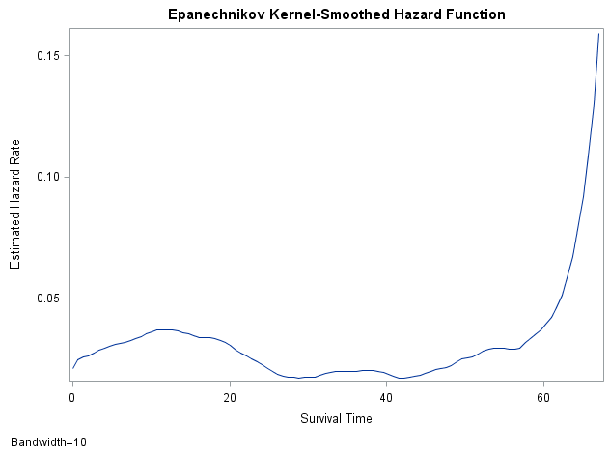
Descriptive analysis
Kaplan-Meier survival curve
Estimated hazard function
Mean ± SD survival time:
32.1 ± 4.0 months from Dx

Slide 8
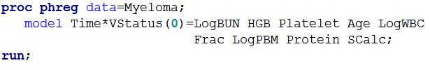

Inferential analysis: the model
Cox proportional hazards regression
$$h\left(t\right)=λ_{0}\left(t\right)e^{β_{1}x_{1}+β_{2}x_{2}…}$$

Slide 9
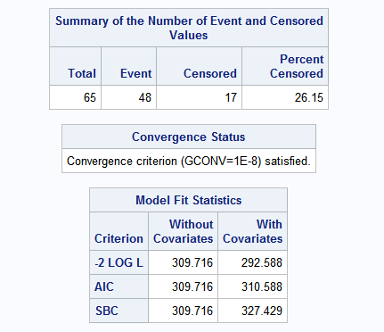
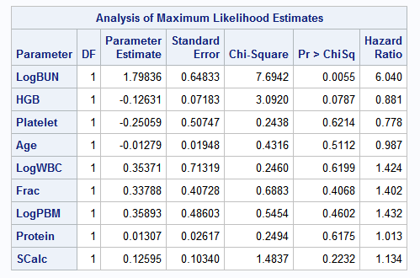

Inferential analysis: the model
Cox proportional hazards regression
$$h\left(t\right)=λ_{0}\left(t\right)e^{1.798∗LogBUN−0.126∗HGB+…}$$

Slide 10
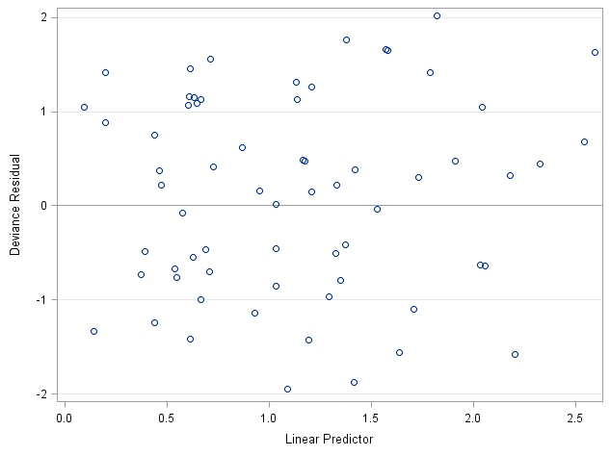
Inferential analysis: model fit
Assessing model fit (as usual, with residuals)

Slide 11
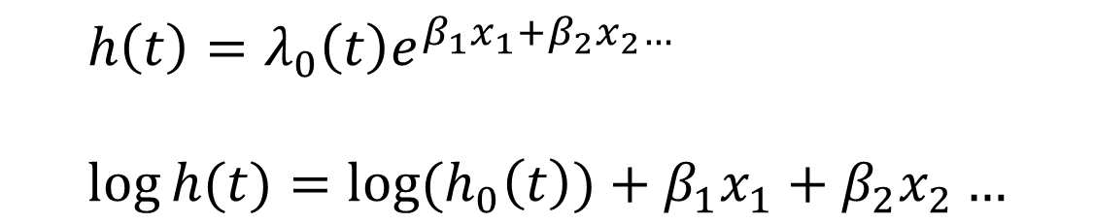
Inferential analysis: assumptions
Assessing model assumptions: log-linearity
covariates assumed to have linear relation with log of hazard
$$h\left(t\right)=λ_{0}\left(t\right)e^{β_{1}x_{1}+β_{2}x_{2}…}$$
$$\log{h(t)}=log⁡(h_{0}\left(t\right){)+β}_{1}x_{1}+β_{2}x_{2}…$$

Slide 12
Inferential analysis: assumptions
Assessing model assumptions: log-linearity
covariates assumed to have linear relation with log of hazard
simple test: add quadratic terms and test for significant non-linearity; and,
bin continuous covariates and examine estimates for each stratum

Slide 13
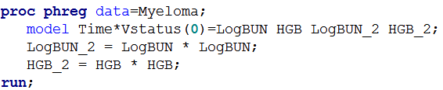
Inferential analysis: assumptions
Assessing model assumptions: log-linearity
covariates assumed to have linear relation with log of hazard
add quadratic terms and test for significant non-linearity
quadratic terms

Slide 14
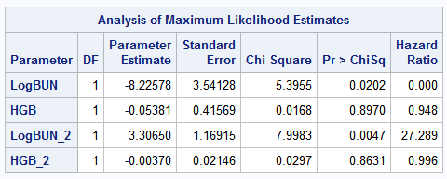
Inferential analysis: assumptions
Assessing model assumptions: log-linearity
covariates assumed to have linear relation with log of hazard
add quadratic terms and test for significant non-linearity
quadratic terms

Slide 15
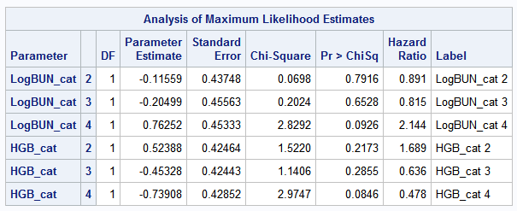
Inferential analysis: assumptions
Assessing model assumptions: log-linearity
covariates assumed to have linear relation with log of hazard
bin continuous covariates and examine estimates for each stratum
original variable binned into quartiles

Slide 16
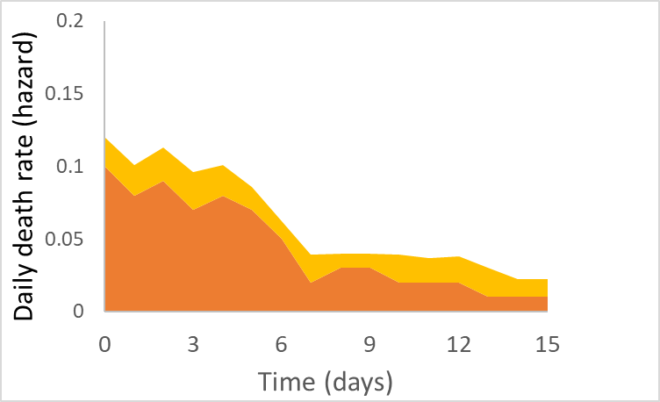
Inferential analysis: assumptions
Assessing model assumptions: proportional hazards
hazard ratios assumed to be constant over time
Hazard ratio = h₁(t) / h₂(t)
group 1 h₁(t)
group 2 h₂(t)

Slide 17
Inferential analysis: assumptions
Assessing model assumptions: proportional hazards
hazard ratios assumed to be constant over time
simple test: create new variables as
[original variable] x [log(time)]
and test for significance (change in effect over time); and,
examine survival curves by strata and look for obvious non-proportionality (non-parallel lines)

Slide 18
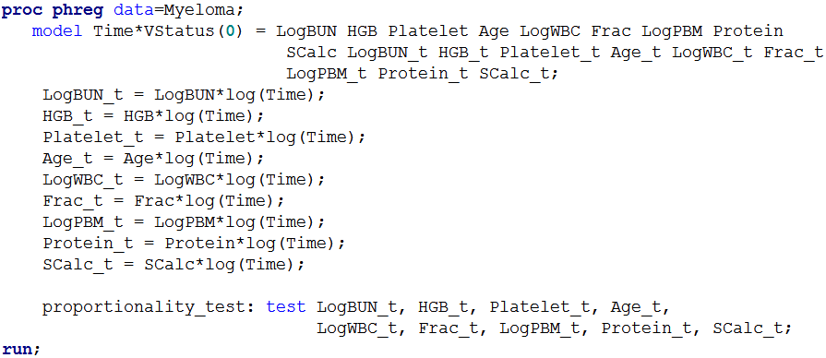
Inferential analysis: assumptions
Assessing model assumptions: proportional hazards
hazard ratios assumed to be constant over time
create new variables as [original variable] x [log(time)] and test for significance (change in effect over time)
New variables: original variable x log(time)

Slide 19

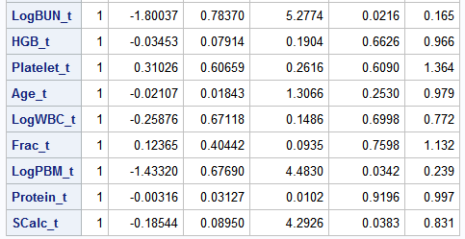
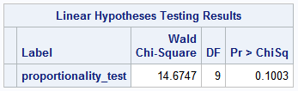
Inferential analysis: assumptions
Assessing model assumptions: proportional hazards
hazard ratios assumed to be constant over time
create new variables as [original variable] x [log(time)] and test for significance (change in effect over time)

Slide 20
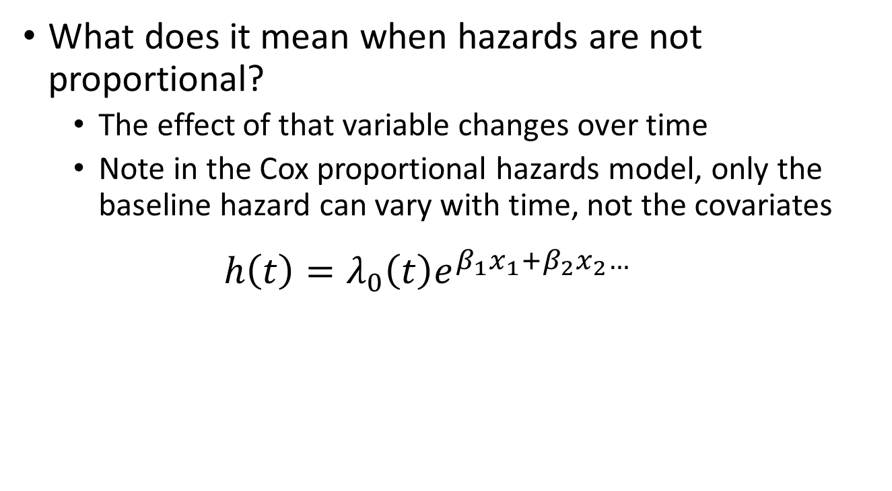
Non-proportional hazards
What does it mean when hazards are not proportional?
The effect of that variable changes over time
Note in the Cox proportional hazards model, only the baseline hazard can vary with time, not the covariates
$$h\left(t\right)=λ_{0}\left(t\right)e^{β_{1}x_{1}+β_{2}x_{2}…}$$
Baseline covariates
hazard

Slide 21
Extended Cox regression model
The Cox proportional hazards regression utilizes fixed covariates (e.g., measured at baseline and do not change over time)
However, the ‘extended Cox regression model’ can be used to incorporate time-dependent covariates (covariates whose values change over time)

Slide 22

Extended Cox regression model
As a simple example, we might have covariate that changes value from 0 to 1 at time z for each patient
In this case the simple model of the hazard would be:
$$h\left(t\right)=λ_{0}\left(t\right)e^{β_{1}x_{1}}$$
${ λ}_{0}\left(t\right)$
$${ λ}_{0}\left(t\right)e^{β_{1}x_{1}}$$
before time z
at or after time z

Slide 23
References
Columbia University Mailman School of Public Health. Population Health Methods. Time to event data analysis. https://www.mailman.columbia.edu/research/population-health-methods/time-event-data-analysis
George H. Dunteman & Moon-Ho R. Ho. 2011. Survival Analysis. In, An Introduction to Generalized Linear Models. SAGE Publications, Inc.
Krall, J. M., Uthoff, V. A., and Harley, J. B. 1975. A Step-up Procedure for Selecting Variables Associated with Survival. Biometrics 31: 49–57.
McCullagh P, Nelder JA. 1989. Generalized Linear Models. Chapman & Hall.
O'Quigley, J., 2008. Proportional hazards regression (Vol. 542). New York: Springer.
Sainani, K.L. Introduction to Survival Analysis. Stanford University Department of Health Research and Policy. https://web.stanford.edu/~kcobb/index.html

